Slide 1
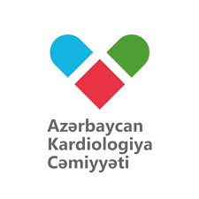


Importance of early myocardial revascularization in STEMI patients
Elnur Isayev, MD, PhD
Azerbaijan Medical University
10.12.2022

Slide 2
Elnur Isayev, MD, PhD / 10.12.2022

Slide 3
History of definition of MI
Elnur Isayev, MD, PhD / 10.12.2022

Slide 4
Definition of AMI
The term acute myocardial infarction (AMI) should be used when there is evidence of myocardial injury (defined as an elevation of cardiac troponin values) with necrosis in a clinical setting consistent with myocardial ischaemia.
Luepker RV, et al . Case definitions for acute coronary heart disease in epidemiology and clinical research studies: A statement from the AHA Council on Epidemiology and Prevention; AHA Statistics Committee; World Heart Federation Council on Epidemiology and Prevention; the European Society of Cardiology Working Group on Epidemiology and Prevention; Centers for Disease Control and Prevention; and the National Heart, Lung, and Blood Institute. Circulation 2003;108:2543–2549.
Elnur Isayev, MD, PhD / 10.12.2022

Slide 5
Spectrum of Myocardial Injury
Elnur Isayev, MD, PhD / 10.12.2022

Slide 6
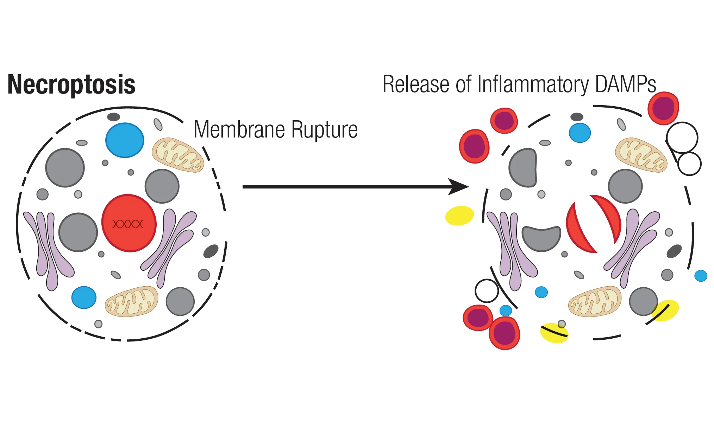
Pathological characteristics of MI
MI is defined pathologically as myocardial cell death due to prolonged ischaemia.
Diminished cellular glycogen, and relaxed myofibrils and sarcolemmal disruption, are the first ultrastructural changes and are seen as early as 10–15 min after the onset of ischaemia.
Mitochondrial abnormalities are observed as early as 10 min after coronary occlusion by electron microscopy and are progressive.
Jennings RB, Ganote CE. Structural changes in myocardium during acute ischemia. Circ Res 1974;35:156–172.
Virmani R, Forman MB, Kolodgie FD. Myocardial reperfusion injury. Histopathological effects of perfluorochemical. Circulation 1990;81:IV57–IV68.
Elnur Isayev, MD, PhD / 10.12.2022

Slide 7
MI Types 1 and 2
Elnur Isayev, MD, PhD / 10.12.2022

Slide 8
History of Mortality
Short-term mortality after acute MI had a significant decline, decreasing from more than 30% in the 1950s to 5–8% nowadays.
Roe MT, Messenger JC, Weintraub WS, Cannon CP, Fonarow GC, Dai D,et al. Treatments, trends, and outcomes of acute myocardial infarction and percutaneous coronary intervention. J Am Coll Cardiol 2010;56:254-63.
McManus DD, Gore J, Yarzebski J, Spencer F, Lessard D, Goldberg RJ. Recent trends in the incidence, treatment, and outcomes of patients with STEMI and NSTEMI. Am J Med 2011;124:40-7.
Elnur Isayev, MD, PhD / 10.12.2022

Slide 9
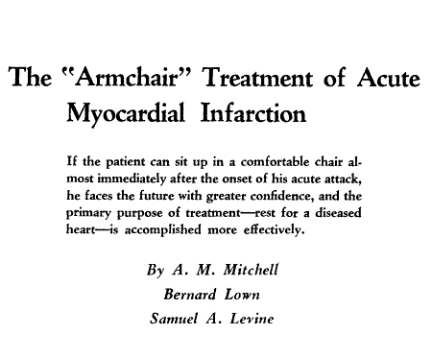
Bed Rest (1900-1960)
Only treatment was total physical and emotional rest for at least six weeks in uncomplicated cases, followed by an even longer period of rest at home.
At that time in-hospital mortality reached 30%.
Levine SA, Lown B. “Armchair” treatment of acute coronary thrombosis. J Am Med Assoc 1952;148:1365-9.
Elnur Isayev, MD, PhD / 10.12.2022

Slide 10
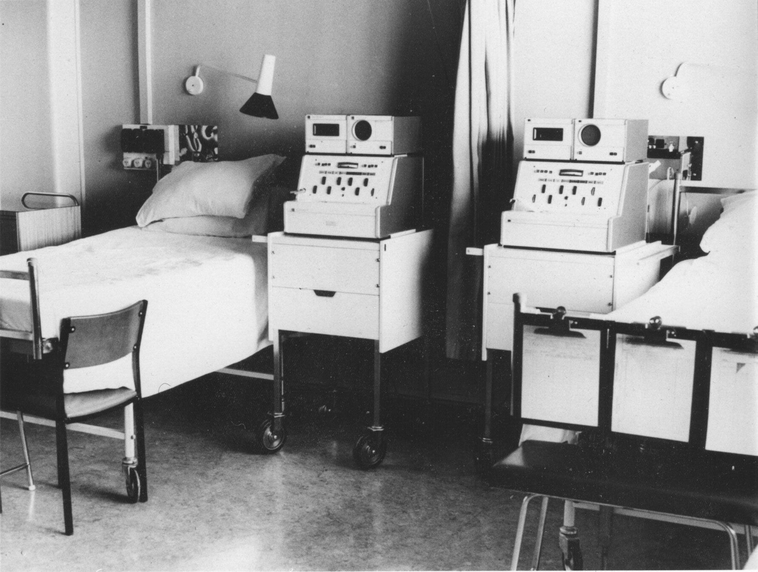
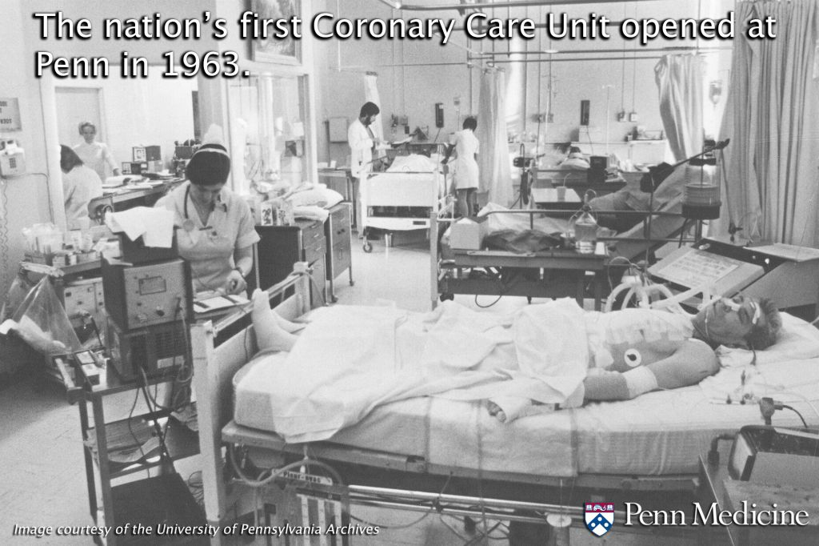
The Coronary Care Unit
Starting from 1961, CCU halved in-hospital mortality, from 30% to around 15%.
The CCU introduced:
  continuous electrocardiogram (ECG) monitoring,
  external defibrillation and
  cardiac resuscitation.
Julian DG. Treatment of cardiac arrest in acute myocardial ischaemia and infarction. Lancet 1961;2:840-4.
Goble AJ, Sloman G, Robinson JS. Mortality reduction in a coronary care unit. Br Med J 1966;1:1005-9.
Elnur Isayev, MD, PhD / 10.12.2022

Slide 11
The Reperfusion ERA
In 1879 by the pathologist Ludvig Hektoen hypotesized that MI was caused by an abrupt cessation of the blood flow to the myocardium “secondary to sclerotic changes in the coronaries”.
In 1986 the GISSI trial showed that IV thrombolytic treatment with streptokinase reduced early mortality in patients with MI by restoring blood flow and reducing the infarct size.
However, thrombolysis has several complications (mainly major bleeding), is effective in restoring blood flow in only 50-60% of the cases.
Effectiveness of intravenous thrombolytic treatment in acute myocardial infarction. Gruppo Italiano per lo Studio della Streptochinasi nell’Infarto Miocardico (GISSI). Lancet 1986;1:397-402.
Elnur Isayev, MD, PhD / 10.12.2022

Slide 12
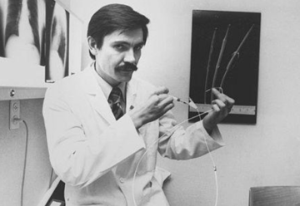
Coronary Arteriography
1958 – introduced as a diagnostic tool to evaluate vessels anatomy.
1964 - Dotter and Judkins were firsts to describe a transluminal approach to atherosclerotic coronary obstructions.
1979 - Gruntzig is considered the father of percutaneous interventional cardiology.
1993 - primary percutaneous coronary intervention (PCI) was demonstrated to be superior to fibrinolysis in reducing mortality after MI.
Grines CL, Browne KF, Marco J, Rothbaum D, Stone GW, O’Keefe J, et al. A comparison of immediate angioplasty with thrombolytic therapy for acute myocardial infarction. The Primary Angioplasty in Myocardial Infarction Study Group. N Eng J Med 1993;328:673-9.
Elnur Isayev, MD, PhD / 10.12.2022

Slide 13
Mortality after PCI
A large observational study demonstrated that the reduction of short-term mortality after MI decreased by 80% from 1985 to 2008, whereas long-term mortality was reduced only by 40% in the same period.
Incidence rates of HF after MI remained relatively stable from 1975 to 1991 (around 26%) but decreased thereafter, and today HF after MI develops in approximately 12% of patients.
Nauta ST, Deckers JW, Akkerhuis KM, van Domburg RT. Short- and long-term mortality after myocardial infarction in patients with and without diabetes: Changes from 1985 to 2008. Diabetes Care 2012;35:2043-7.
Kaul P, Ezekowitz JA, Armstrong PW, Leung BK, Savu A, Welsh RC, et al. Incidence of heart failure and mortality after acute coronary syndromes. Am Heart J 2013;165:379-85.e2.
Elnur Isayev, MD, PhD / 10.12.2022

Slide 14
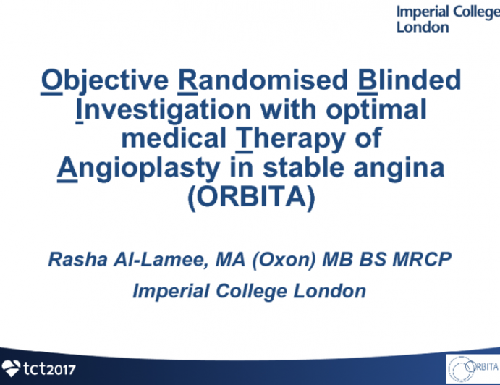
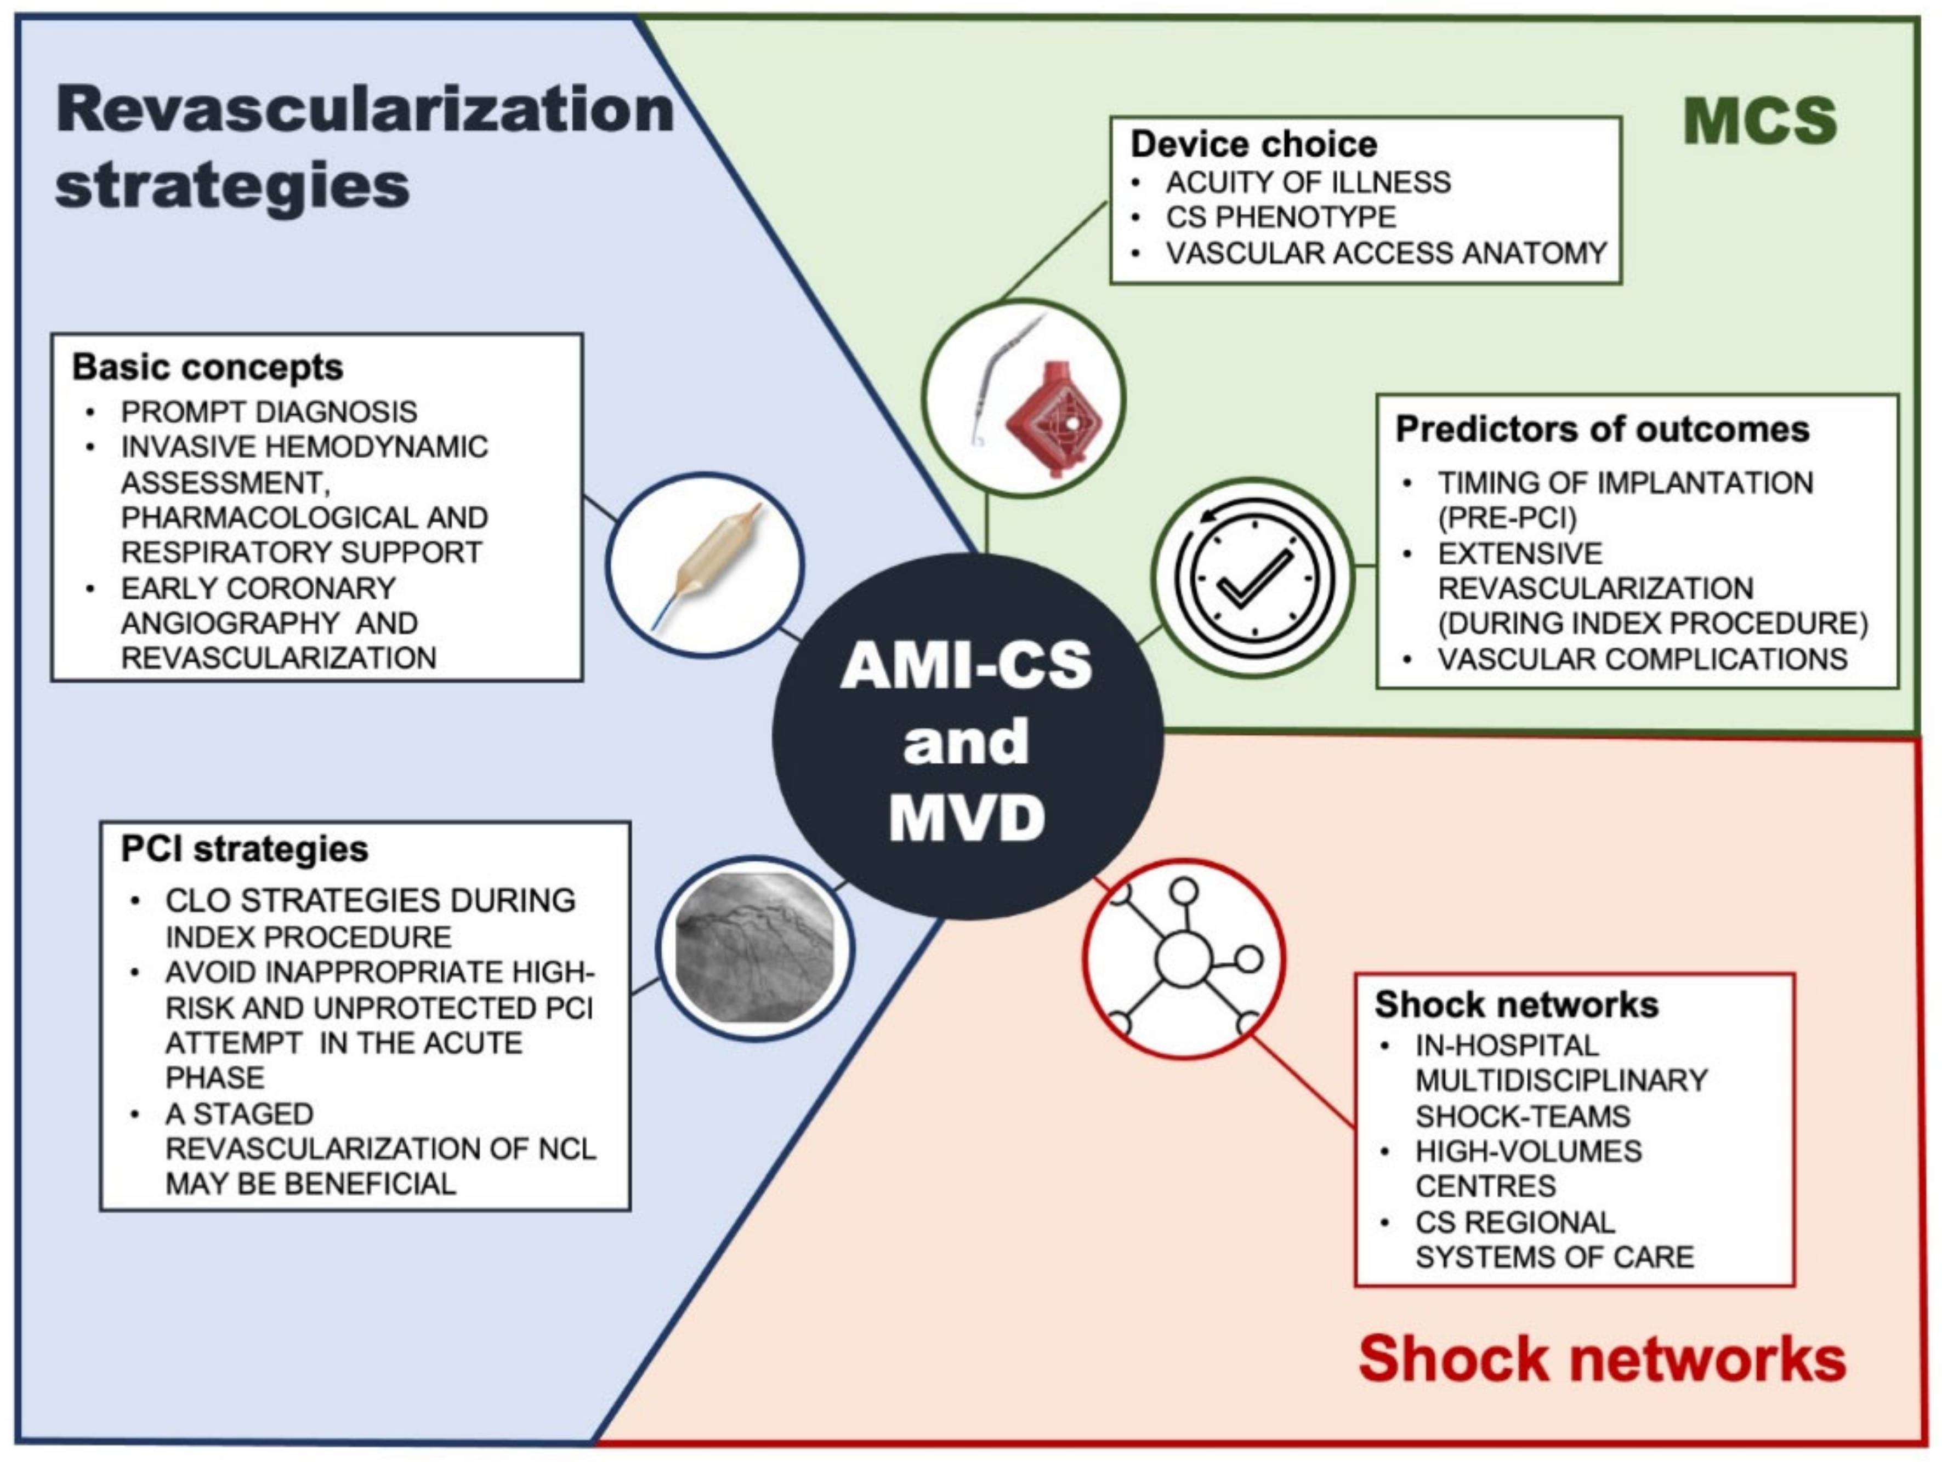
Rationale for Revascularization
ORBITA
FAME 2
SYNTAX
FREEDOM
EXCEL
Elnur Isayev, MD, PhD / 10.12.2022

Slide 15
Flowchart for reperfusion strategy
Elnur Isayev, MD, PhD / 10.12.2022

Slide 16
Time delays
FITT-STEMI Trial
2006-2015 years
20.130 STEMI patients
For contact-to-balloon times every 10-min treatment delay led to:
  3.3 additional deaths in 100 PCI-treated patients and
  1.3 additional deaths after out-of-hospital cardiac arrest without cardiogenic shock.
Elnur Isayev, MD, PhD / 10.12.2022

Slide 17
Time Saving
This treatment delay-related increase in mortality rate within the early hours of infarction was 10- fold higher in shock patients as compared to haemodynamically stable patients.
Study confirm that pre-hospital diagnosis of STEMI and early notification of on-call cardiac catheterization teams by a physician trained in emergency medicine, minimizes prognosis-relevant delays in the time to PCI treatment, which results in a time saving of more than 15 min.
Elnur Isayev, MD, PhD / 10.12.2022

Slide 18
Preventing Death
One death among 12 STEMI patients can be prevented in the total population when the time from the first medical contact to reperfusion is reduced to the guideline-recommended treatment time to less than 90 min.
Ibanez B, James S, et al; ESC Scientific Document Group. 2017 ESC Guidelines for the management of acute myocardial infarction in patients presenting with ST-segment elevation: the task force for the management of acute myocardial infarction in patients presenting with ST-segment elevation of the European Society of Cardiology (ESC). Eur Heart J 2018;39:119–177.
Elnur Isayev, MD, PhD / 10.12.2022

Slide 19
Selection of reperfusion strategy
Primary PCI, defined as percutaneous catheter intervention in the setting of STEMI without previous fibrinolysis, is the preferred reperfusion strategy.
Can be performed in high-volume PCI centres with experienced operators and 24 h/7 days a week catheterization laboratory activation.
Ibanez B, James S, et al; ESC Scientific Document Group. 2017 ESC Guidelines for the management of acute myocardial infarction in patients presenting with ST-segment elevation: the task force for the management of acute myocardial infarction in patients presenting with ST-segment elevation of the European Society of Cardiology (ESC). Eur Heart J 2018;39:119–177.
Elnur Isayev, MD, PhD / 10.12.2022

Slide 20
Selection of reperfusion strategy
In settings where primary PCI cannot be performed in a timely fashion, fibrinolysis should be administered as soon as possible.
It should be followed by transfer to PCI-capable centres for routine coronary angiography in all patients, and should be performed without delay for rescue PCI in the case of unsuccessful fibrinolysis or within 2–24 h after bolus administration.
Ibanez B, James S, et al; ESC Scientific Document Group. 2017 ESC Guidelines for the management of acute myocardial infarction in patients presenting with ST-segment elevation: the task force for the management of acute myocardial infarction in patients presenting with ST-segment elevation of the European Society of Cardiology (ESC). Eur Heart J 2018;39:119–177.
Elnur Isayev, MD, PhD / 10.12.2022

Slide 21
Reperfusion strategy according to time
Elnur Isayev, MD, PhD / 10.12.2022

Slide 22
Primary PCI
The infarct-related artery (IRA) should be systematically treated during the initial intervention.
Most of the studies support the concept of full revascularization either during the initial hospital stay for STEMI or a staged admission.
Radial access is preferred over femoral access.
Ibanez B, James S, et al; ESC Scientific Document Group. 2017 ESC Guidelines for the management of acute myocardial infarction in patients presenting with ST-segment elevation: the task force for the management of acute myocardial infarction in patients presenting with ST-segment elevation of the European Society of Cardiology (ESC). Eur Heart J 2018;39:119–177.
Elnur Isayev, MD, PhD / 10.12.2022

Slide 23
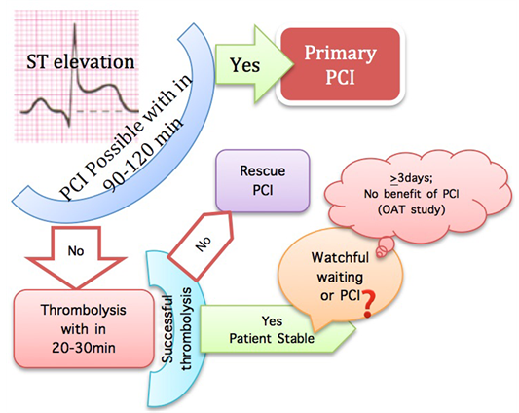
PCI after thrombolysis
The benefits of early, routine PCI after thrombolysis were seen in the absence of an increased risk of adverse events (stroke or major bleeding).
A time frame of 2–24 h after successful lysis is recommended.
In cases of failed fibrinolysis, or if there is evidence of re-occlusion or reinfarction with recurrence of ST-segment elevation, the patient should undergo immediate coronary angiography and rescue PCI.
Di Mario C, et al; CARES-in-AMI Investigators. Immediate angioplasty versus standard therapy with rescue angioplasty after thrombolysis in the Combined Abciximab REteplase Stent Study in Acute Myocardial Infarction (CARESS-in-AMI): An open, prospective, randomised, multicentre trial. Lancet 2008;371:559–568.
Gershlick Ahet al; REACT Trial Investigators. Rescue angioplasty after failed thrombolytic therapy for acute myocardial infarction. N Engl J Med 2005;353:2758–2768.
Elnur Isayev, MD, PhD / 10.12.2022

Slide 24
Late PCI
Patients presenting between 12 and 48 h after the onset of symptoms, even if pain free and with stable haemodynamics, may still benefit from early coronary angiography and possibly PCI.
In patients presenting days after the acute event with a completed MI, only those with recurrent angina or documented residual may be considered for revascularization when the infarct artery is occluded.
Busk M, Kaltoft A, Nielsen SS, Bottcher M, Rehling M, Thuesen L, Botker HE, Lassen JF, Christiansen EH, Krusell LR, Andersen HR, Nielsen TT, Kristensen SD. Infarct size and myocardial salvage after primary angioplasty in patients presenting with symptoms for <12 h vs. 12-72 h. Eur Heart J 2009;30:1322–1330.
Elnur Isayev, MD, PhD / 10.12.2022

Slide 25
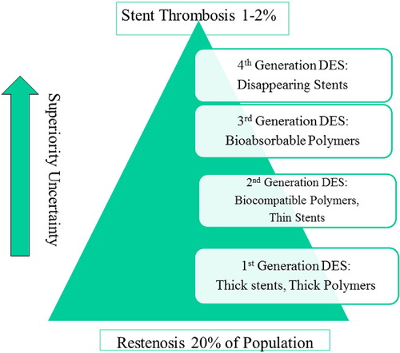
Drug-Eluting Stents
In patients with STEMI, DES (in particular new-generation DES) have demonstrated better efficacy as compared with BMS.
DES should be used as the default strategy in STEMI patients, even when DAPT cannot be sustained beyond 1 month.
Raber L, Kelbaek H, Ostojic M, Baumbach A, Heg D, Tuller D, von Birgelen C, Roffi M, Moschovitis A, Khattab AA, Wenaweser P, Bonvini R, Pedrazzini G, Kornowski R, Weber K, Trelle S, Luscher TF, Taniwaki M, Matter CM, Meier B, Juni P, Windecker S; COMFORTABLE AMI Trial Investigators. Effect of biolimus-eluting stents with biodegradable polymer vs bare-metal stents on cardiovascular events among patients with acute myocardial infarction: The COMFORTABLE AMI randomized trial. JAMA 2012;308:777–787.
Elnur Isayev, MD, PhD / 10.12.2022

Slide 26
Treatment never ends…
Elnur Isayev, MD, PhD / 10.12.2022

Slide 27
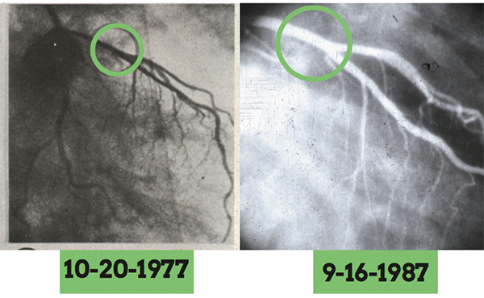
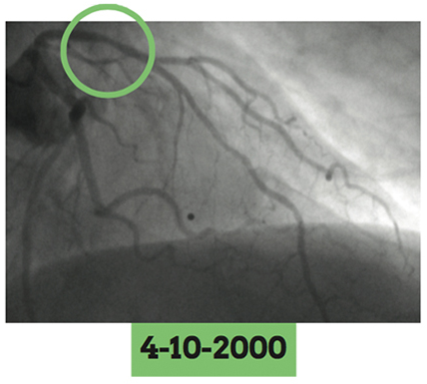
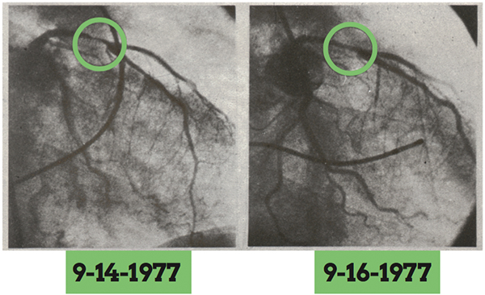
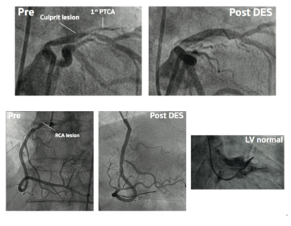
First Angioplasty
Thank You...
2014

